Slide 1
Revelation 1

Slide 2
Revelation 1 – Symbolism vs Figurative Language
Symbolism
Vs
Figurative Language

Slide 3
Revelation - Symbolism vs Figurative Language
Symbolism - One thing represents another thing
Jesus
Satan
Wealth/Power
Peace
Persons, Gov
All-Seeing
Heaven
Authority
Power, Control
Strength
Evil
Lamb, Alpha, Omega, Lion
Serpent / Snake / Dragon
Jewels, Metals
Palm Leaf
Beasts
Eyes
Gold / Clear / Transparent
Heads on a creature
Crowns
Horns
Egypt, Babylon
Use your knowledge of Bible, History

Slide 4
Revelation - Symbolism vs Figurative Language
Figurative Language
The ability to construct linguistic meaning from written representations of a language
Appeals to cognitive comprehension
Inside comment, inside joke, or coded message
“Cat’s in the cradle”
“Last week, my car keys grew legs”
“Intoxicated with power”
“Neck-deep in trouble”
“I don’t chew my cabbage twice”
“He that has an ear to hear, let him hear.”
“To him that overcometh will I give to eat of the tree of life …”
“Here is wisdom” (a clue is being presented)

Slide 5
Revelation 1 – Symbolism vs Figurative Language
Figurative language is usually more complicated than symbolic language because we tend to take figurative language literally at first glance.
Figurative language is usually more complicated than symbolic language because we tend to take figurative language literally at first glance.
Notes:
Symbolic language refers to a “noun”
Figurative language refers to a “concept”

Slide 6
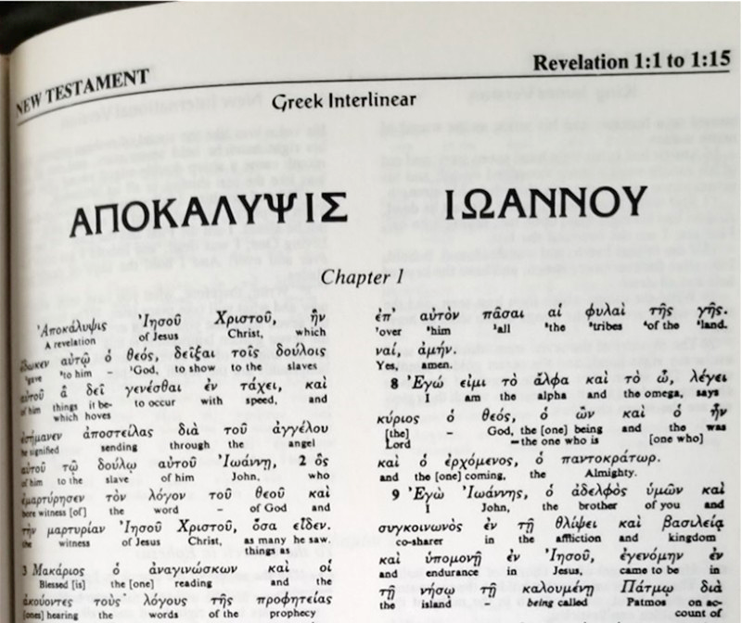
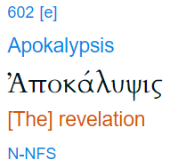
Revelation 1 - Controversy #1
¹
²
¹ https://www.lingq.com/en/learn-greek-online/translate/el/Ιωάννου
² biblehub.com
Notes:
Image of my Greek Interlinear.
Word on left is Greek word translated “Revelation”.
Word on right is Greek word translated “John”.
https://www.lingq.com/en/learn-greek-online/translate/el/Ιωάννου
“A revelation of Jesus Christ . . . “ – Same Greek word as title

Slide 7
Revelation 1 - Controversy #1
Greek: “ΑΠΟΚΑΛΥΨΙΣ” (majuscule)
Transliterated: “APOKALYPSIS”
English: “apocalypse”
Occurrences: 18x in NT ¹
Every instance : “revealing”, “unveiling” ²
(Greek) “to pull the lid off of something”
Theater curtains drawing back
Luke 2:32 Rom. 2:5
Rom. 8:19
Rom. 16:25
1 Cor. 1:7
1 Cor. 14:6
1 Cor. 14:26
2 Cor. 12:1
2 Cor. 12:7
Gal. 1:12
Gal. 2:2
Eph. 1:17
Eph. 3:3
2 Thess. 1:7
1 Peter 1:7
1 Peter 1:13
1 Peter 4:13
Rev. 1:1
¹ Strong’s Concordance (biblehub.com)
² https://biblehub.com/greek/strongs_602.htm
Notes:
Why is it not translated as “end of the world” or “end of times” or “cataclysmic event”?

Slide 8
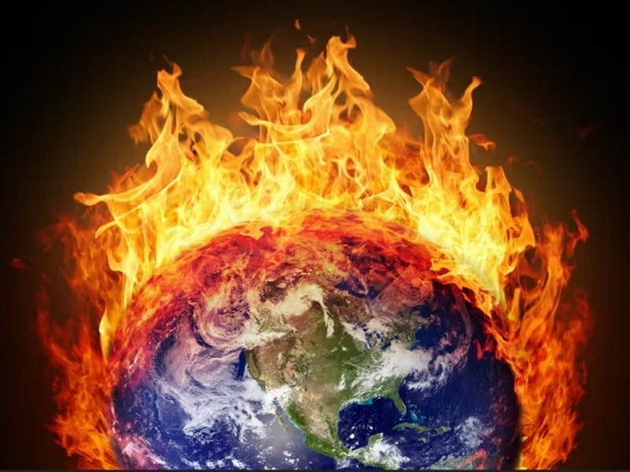
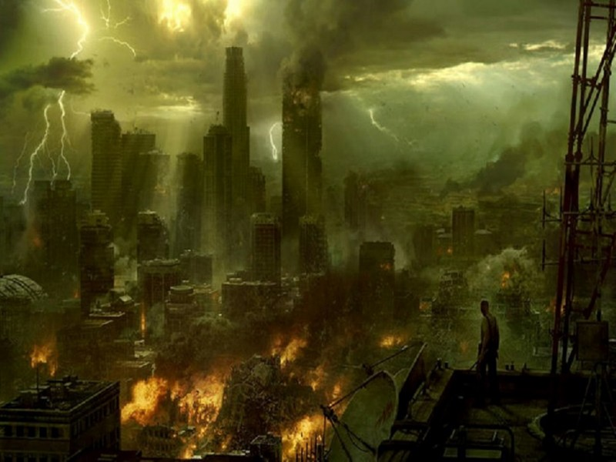
Revelation 1 - Controversy #1
Notes:
Apocalypse?
End of the world?
End of time?
With fire and flame?
Scorching the earth into oblivion?

Slide 9
Revelation - Apocalypse (1 / 3)
“Apocalypse comes from Greek, the original language of the Book of Revelation. It means “uncover, disclose, reveal.” In late 14th century Church Latin, it became “revelation”. In Middle English, its general sense was “insight” or “vision”.
Its usage as “a cataclysmic event” is modern. By 1858, it had come to mean “belief in an imminent end of the present world”.
Daily News
Pete Haug
https://dnews.com/opinion/his-view-apocalypse-now-lets-explore-its-true-meaning/article_becac39c-6de4-11ea-9044-832fa09381b6.html

Slide 10
Revelation - Apocalypse (2 / 3)
Apocalypse:
“Its general sense in Middle English was "insight, vision, hallucination." The meaning "a cataclysmic event" is modern (not in Oxford English Dictionary 2nd edition, 1989); apocalypticism, the belief in an imminent end of the present world, is from 1858.”
Online Etymology Dictionary
https://www.etymonline.com/word/apocalypse

Slide 11
Revelation - Apocalypse (3 / 3)
Apocalypticism:
“A doctrine concerning an imminent end of the world and an ensuing general resurrection and final judgment.”
First Known Use of apocalypticism: 1858, in the meaning defined above.
Merriam-Webster Dictionary Online
https://www.merriam-webster.com/dictionary/apocalypticism
Do not apply modern-day definitions to words and phrases written 2000 years ago.
Notes:
How much more intellectually dishonest can you get than that?
Any objections to this conclusion?
We are going to hit this same situation again in a little while.

Slide 12
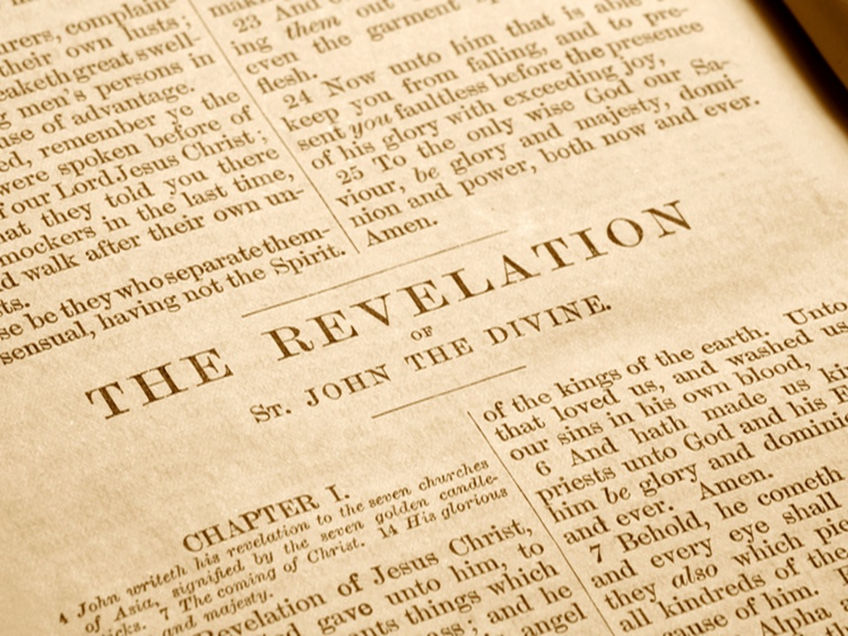
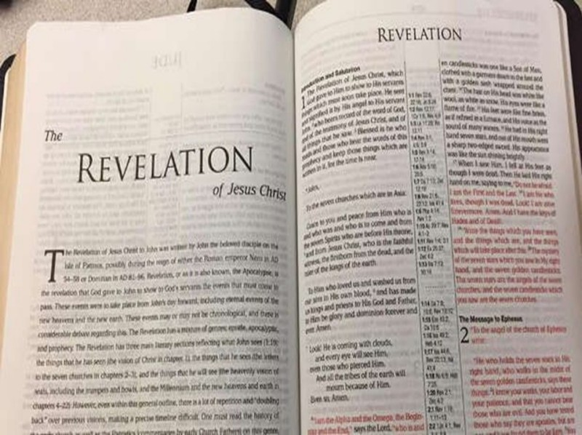
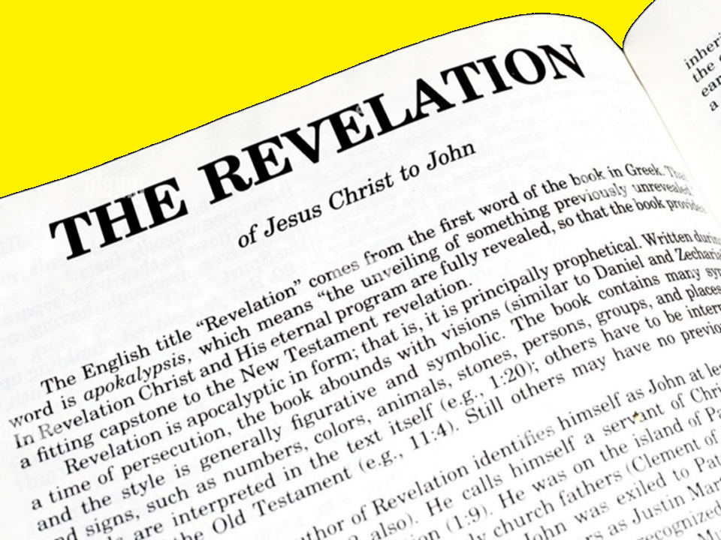
Revelation 1 - Controversy #2
Notes:
Whose “revelation” is this?

Slide 13
Revelation 1:1 - Controversy #2
¹ The Revelation [of] ¹ Jesus Christ, which God gave unto him, to shew unto his servants things which must shortly come to pass; and he sent and signified it by his angel unto his servant John:
Who owns this revelation?
God’s
Who is missing in Rev. 1:1?
Holy Spirit
If Holy Spirit is missing, how do we know that John and the book of Revelation is inspired?
Must prove from Revelation
¹ “at”, “with”, “to”, “unto“, in possession of but not ownership - https://biblehub.com/greek/ie_sou_2424.htm
Notes:
Ordinarily, this would not be a trick question.
But, with all the mis-information and contradictions of the title pages, it has become a trick question.
2 Tim 3:16
All scripture is given by inspiration of God, and is profitable for doctrine, for reproof, for correction, for instruction in righteousness:
You cannot answer a Pre-M with scriptures outside of Revelation.

Slide 14
Revelation 1:2
Revelation 1:2
² Who bare record of the word of God, and of the testimony of Jesus Christ, and of all things that he saw.
Historically, book prefaces written after the book
John declares his record is true and complete
Notes:
Historically, book prefaces written afterwards ¹
Rev 1:1-9 written after Revelation written?
Rev 1:1-9 acts as a preface to Revelation
Preface: John says that he faithfully recorded what he saw and what he heard.
John exiled to Patmos from the persecution according to his own words.
He preached against emperor worship
By providence of God, John receives vision while on Patmos
But, this verse leaves some latitude to interpret this as a witness to the Revelation vision.
https://books.google.com/books?id=8swjDQAAQBAJ&pg=PT105&lpg=PT105&dq=emartyr%C4%93sen&source=bl&ots=EqaUCK5WMa&sig=ACfU3U02eOYbIRL2HKrK-ET5X1N8HxQbfw&hl=en&sa=X&ved=2ahUKEwj0kKvy3cP4AhW3K0QIHUTjD0UQ6AF6BAgiEAM#v=onepage&q=emartyr%C4%93sen&f=false

Slide 15
Revelation 1:9
Revelation 1:9
⁹ I John, who also am your brother, and companion in tribulation, and in the kingdom and patience of Jesus Christ, was in the isle that is called Patmos, for the word of God, and for the testimony of Jesus Christ.
5x - “Word of God” , “Testimony of Jesus Christ”
4x - “Testimony”
Rev 1:9 - Referring to Gospel or Revelation vision?
Notes:
Historically, book prefaces written afterwards ¹
Rev 1:1-9 written after Revelation written?
Rev 1:1-9 acts as a preface to Revelation
Preface: John says that he faithfully recorded what he saw and what he heard.
John exiled to Patmos from the persecution according to his own words.
He preached against emperor worship
By providence of God, John receives vision while on Patmos
But, this verse leaves some latitude to interpret this as a witness to the Revelation vision.
https://books.google.com/books?id=8swjDQAAQBAJ&pg=PT105&lpg=PT105&dq=emartyr%C4%93sen&source=bl&ots=EqaUCK5WMa&sig=ACfU3U02eOYbIRL2HKrK-ET5X1N8HxQbfw&hl=en&sa=X&ved=2ahUKEwj0kKvy3cP4AhW3K0QIHUTjD0UQ6AF6BAgiEAM#v=onepage&q=emartyr%C4%93sen&f=false

Slide 16
Revelation 1:9 - Patmos
Revelation 1:9
⁹ I John, who also am your brother, and companion in tribulation, and in the kingdom and patience of Jesus Christ, was in the isle that is called Patmos, for the word of God, and for the testimony of Jesus Christ.
Oral tradition:
“John was exiled as prisoner to a Patmos penal colony, working in salt mines.”
Oral tradition inconsistent with:
Tacitus (56 - 120 AD)
Prochorus’ writings
Notes:
Jerome
Domitian banished John to Patmos
No mention of penal colony, salt mines, being a prisoner in chains
Tacitus, 1st century Roman historian, lists exile islands:
Gyarus, Donusa, Amorgus; never Patmos
No 1st or 2nd historian mentions:
Salt mines, John bound prisoner, penal colony

Slide 17
Revelation 1:9 - Patmos
Revelation 1:9
⁹ I John, who also am your brother, and companion in tribulation, and in the kingdom and patience of Jesus Christ, was in the isle that is called Patmos, for the word of God, and for the testimony of Jesus Christ.
The Dustin Martyr Blog:
In “Annals” B4 Ch30, Tacitus refers to the islands of Gyarus/Gyaros, Donusa, and Amorgus as locations (which he is aware of) used for the Roman punishment of banishment.” ¹
¹ https://dustinmartyr.wordpress.com/2014/02/18/insights-on-the-apocalypse-of-john-why-was-john-on-patmos/

Slide 18
Revelation 1:9 - Patmos
Revelation 1:9
⁹ I John, who also am your brother, and companion in tribulation, and in the kingdom and patience of Jesus Christ, was in the isle that is called Patmos, for the word of God, and for the testimony of Jesus Christ.
Pliny The Elder (23 - 79 AD) (“Natural History” B3 Ch12 Vs69)
“Tacitus (56-120 AD) (Annals B3 Ch68) is often cited by scholars in favor of the exile interpretation, but this text only demonstrates that banishment to islands was a regularly practiced punishment. Patmos is not listed by Tacitus…
¹ https://dustinmartyr.wordpress.com/2014/02/18/insights-on-the-apocalypse-of-john-why-was-john-on-patmos/
Notes:
Pliny the Elder (23-79 AD) refers to Patmos, but never as a penal colony.

Slide 19
Revelation 1:9 - Patmos
Revelation 1:9
⁹ I John, who also am your brother, and companion in tribulation, and in the kingdom and patience of Jesus Christ, was in the isle that is called Patmos, for the word of God, and for the testimony of Jesus Christ.
Gordon Franz
“In the first century Roman world, Patmos was a very strategic island on the sea lanes from Ephesus to Rome. The first stop on this line of communication and commerce for a boat sailing from Ephesus to Rome would have been Patmos, because of its natural and protective harbor. The last stop for a boat coming from Rome would be Patmos. This island had a large administrative center, outlying villages, a hippodrome (for horse racing) and at least three pagan temples. Hardly an isolated and desolate place.” ¹
¹ https://www.pre-trib.org/pretribfiles/pdfs/Franz-TheKingAndITheHistor.pdf

Slide 20
Revelation 1:9 - Patmos
Revelation 1:9
⁹ I John, who also am your brother, and companion in tribulation, and in the kingdom and patience of Jesus Christ, was in the isle that is called Patmos, for the word of God, and for the testimony of Jesus Christ.
“The King and I: Exiled To Patmos, Part 2”
According to church tradition, the book, “Travels of St. John In Patmos”, was written by Prochorus (Acts 6:5), secretary to John. If it is historically reliable, John was only banished to the island, not imprisoned. ¹
¹ https://biblearchaeology.org/research/topics-by-chronology/new-testament-era/3099-the-king-and-i-exiled-to-patmos-part-2

Slide 21
Revelation 1:9 - Patmos
Revelation 1:9
⁹ I John, who also am your brother, and companion in tribulation, and in the kingdom and patience of Jesus Christ, was in the isle that is called Patmos, for the word of God, and for the testimony of Jesus Christ.
“Travels of St. John in Patmos” (Prochorus, Acts 6:5)
“On the trip to Patmos, a violent storm arose and a passenger was swept into the sea. John prayed and a wave deposited the young man back on the boat. This miracle gave John opportunity to preach the Gospel. Once on Patmos, the Roman governor, Laurentius, set him free.” ¹
¹ https://biblearchaeology.org/research/topics-by-chronology/new-testament-era/3099-the-king-and-i-exiled-to-patmos-part-2

Slide 22
Revelation 1:9 - Patmos
Revelation 1:9
⁹ I John, who also am your brother, and companion in tribulation, and in the kingdom and patience of Jesus Christ, was in the isle that is called Patmos, for the word of God, and for the testimony of Jesus Christ.
Otto Friedrich August Meinardus
“St. John of Patmos and the Seven Churches of the Apocalypse”
“Laurentius’s father-in-law, Myron, offers the Apostle lodging in his house, and soon Myron’s house became the first church on the island. John healed Apollonides, Myron’s son, who was possessed with the devil, and this miracle led to the conversion of both Chrysippe, Myron’s daughter, and her husband, the Roman governor.” ¹
¹ https://www.amazon.com/Patmos-Churches-Apocalypse-Footsteps-Saints/dp/0892410434

Slide 23
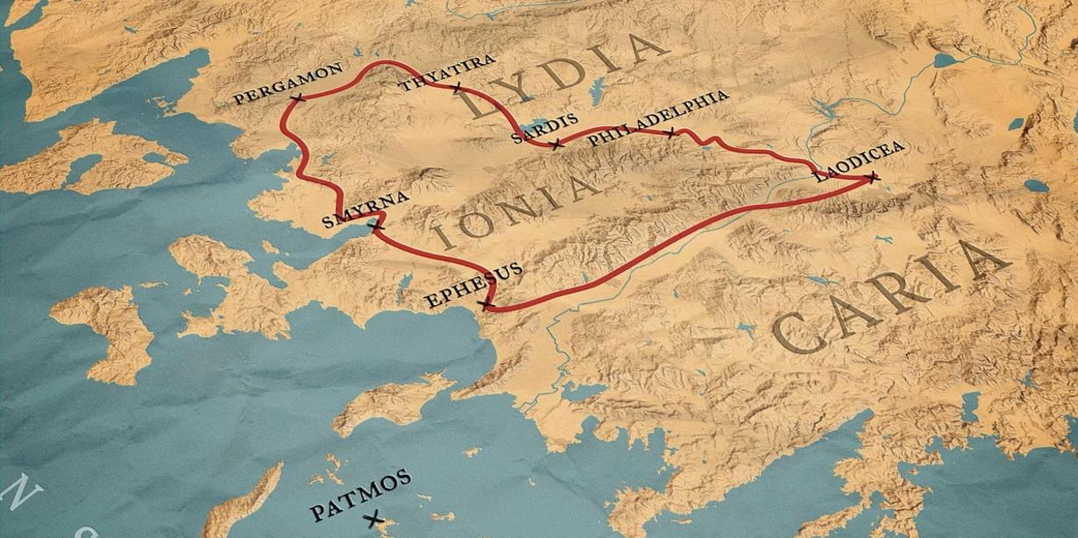
Revelation 1:9 - Why Patmos?
Notes:
Why Patmos?
John may have been permitted to choose his exile location.
Patmos: Inhabited island very close to Ephesus – John’s home town
Defendants in Roman courts could opt for exile and save the court time and money
Sometimes, defendant was allowed to select exile location
Is this what happened with John?
Providence of God?
7 Churches of Asia
Ephesus is nearest to Patmos

Slide 24
Revelation 1:10 - Greek Capitalization
No Greek punctuation until 9th century
Translators started inserting punctuation
Quotation marks
Comma positioning
Exclamation marks
Capitalization
Each at discretion of the translator.
Differences seen across translations
No impact to doctrinal teachings
Reason to study multiple translations
biblehub.com - source 46 translations/versions
Notes:
Why should your Bible study include multiple, reliable translations of the Bible?

Slide 25
Revelation 1:10
¹⁰ I was in the Spirit on the Lord's day, and heard behind me a great voice, as of a trumpet, ¹ (KJV)
KJV does not capitalize “spirit” remaining 3x
Rev 4:2: “in the spirit” ¹
Rev 17:3: “carried away in the spirit” ¹
Rev 21:10: “carried me away in the spirit” ¹
Demonstrates translators’ inconsistency
4x - John claims to be “in the Spirit”
Rev 1:10; 4:2; 17:3; 21:10
¹ biblehub.com
Notes:
Translators try to “help” but …
Where does their attempt to “help” us end?
9 AD is most common date for Greek capitalization

Slide 26
Revelation 1:10
¹⁰ I was in the Spirit on the Lord's day, and heard behind me a great voice, as of a trumpet, ¹ (KJV)
Why does vision require being “in the Spirit”
Message from God accurately recorded
Vision allows John to see into the spirit world
Vision occurs in 5 locations:
Under the earth
On the earth
In heaven (sky where birds fly)
In heaven (location of planets, stars)
In Heaven (abode of God)
1st
2nd
3rd
Notes:
John is seeing places and things that cannot be seen without inspiriation.
2 Cor 12:2 (New American Standard Bible) I know a man in Christ, who fourteen years ago—whether in the body I do not know, or out of the body I do not know, God knows—such a man was caught up to the third heaven.
Does Revelation tells us what the 3rd heaven is?

Slide 27
Revelation 1:10
¹⁰ I was in the Spirit on the Lord's day, and heard behind me a great voice, as of a trumpet, ¹ (KJV)
Inspired? Yes, but different from other N.T. writers
Revelation originated from God (Rev. 1.1)
John claims to be “in the Spirit” 4x
Rev 1:10; 4:2; 17:3; 21:10
God allowed John to see into spiritual realm
John seeing vision and writing at same time
Rev 10:4

Slide 28
Revelation 1:10
¹⁰ I was in the Spirit on the Lord’s Day, and heard behind me a great voice, as of a trumpet, ¹ (NKJV)
Trick Question: What day of week was vision seen?
7 Translations/Versions Capitalize “day” ¹
(discretion of translator)
New International Version
New Living Translation
International Standard Version
New English Translation
New King James Version
Amplified Bible
Literal Standard Version
¹ biblehub.com

Slide 29
Revelation 1:10
40+ Translations/Versions Do Not Capitalize “day” ¹
Biblehub.com
English Standard Version
Berean Study Bible
New American Standard Bible
New American Standard 1995
New American Standard 1977
Christian Standard Bible
Holman Christian Standard Bible
Contemporary English Version
Good News Translation
God's Word Translation
King James Bible
King James 2000 Bible
New Heart English Bible
World English Bible
American King James Version
American Standard Version
A Faithful Version
Darby Bible Translation
English Revised Version
Webster's Bible Translation
Early Modern Geneva Bible,1587
Bishops' Bible of 1568
Coverdale Bible of 1535
Tyndale Bible of 1526
Berean Literal Bible
Young's Literal Translation
Smith's Literal Translation
Literal Translation
Emphasis
Catholic - Douay-Rheims
Catholic Public Domain
Aramaic Bible (Plain English)
Lamsa Bible
Anderson New Testament
Godbey New Testament
Haweis New Testament
Mace New Testament
Weymouth New Testament
Worrell New Testament
Worsley New Testament
¹ biblehub.com

Slide 30
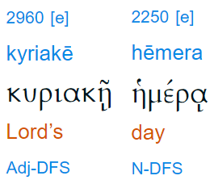
Revelation 1:10
¹
¹ biblehub.com

Slide 31
Revelation 1:10 - “kyriake hemera”
6 Facts
Specific words in specific order only in Rev 1:10
No evidence to interpret as Sunday
Greek all capital letters until ~9th century
“Bias” is not translating, it is indoctrinating
Applying modern definition 1st century phrase
Not to be confused with “day of the Lord”
¹ biblehub.com
Notes:
No cross-reference available
No grammatical evidence supporting this phrase being capitalized and interpreted as Sunday
Of course it is Sunday – Revelation shows us a worship scene in Heaven. *Sigh*
Greek was all-capital letters until ~ 9th century, so any capitalization is the translator’s person interpretation
I don’t want Greek translators interpreting the meaning of a verse. Just give me the English translations and we will interpret it at our level
What if translators had done this elsewhere in the Bible?
Baptism (sprinkling)
Mary (Mother of God)
Arbitrarily capitalizing words at their own whim
Where have see seen this before? Oh yes, “Apolcalypse”
Two completely separate Greek phrases

Slide 32
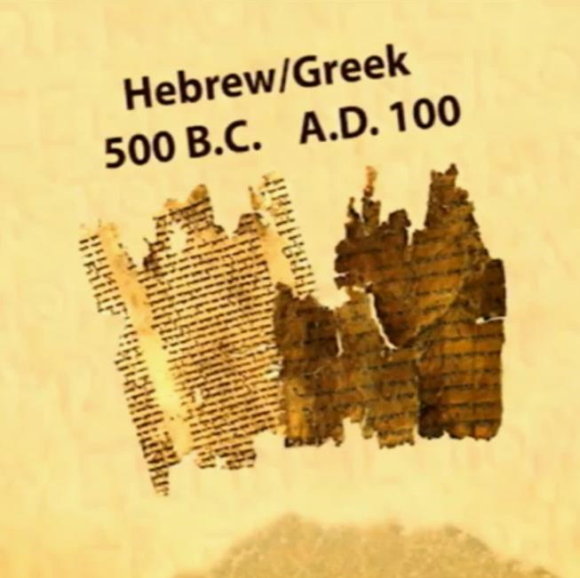
Revelation 1:10 - “kyriake hemera”
Notes:
O.T. writings completed by 500 B.C.
N.T. writings completed by 100 A.D.
Why 100 A.D.?

Slide 33
Revelation 1:10 - “kyriake hemera”
Before leaving Patmos, John was asked by the believers to write an account of the life of the Lord Jesus. This was the Gospel of John according to one tradition [of the 2nd century church].” ^{1, 2}
“Travels of St. John in Patmos”
(Prochorus, Acts 6:5)
¹ “Travels of St. John in Patmos” (Prochorus, Acts 6:5)
² https://biblearchaeology.org/research/topics-by-chronology/new-testament-era/3099-the-king-and-i-exiled-to-patmos-part-2

Slide 34
Revelation 1:10 - “kyriake hemera”
John died during reign of Trajan in Ephesus ¹ (A.D. 98-117)
- If -
Gospel of John was the last Gospel written ²
Gospel of John written by John the Apostle ³
Prochorus’ writings are reliable
- Then -
Gospel of John was written:
After John left Patmos
After Revelation was written
While living in Ephesus in Asia Minor (~100 AD) ³
¹ Irenaeus’ “Against Heresies” Book 3 Ch. 1 Vs. 1
² Eusebius’s “History of the Church” Book 4, Ch. 14 Vs. 7
³ Irenaeus’ “Against Heresies” Book 3 Ch. 1 Vs. 1, student of Polycarp of John
https://thegospelsaves-me.hosted.fivepointtech.com/2016/01/apologetics-when-and-where-was-john-written/

Slide 35
Revelation 1:10 - “kyriake hemera”
“first day of the week” - 8x in N.T. ¹
- If -
Revelation’s “Lord’s day” is new way to reference Sunday
Gospel of John written after Revelation
Why?
Phrase “Lord’s day” not used in Gospel of John?
Instead, “first day of the week” used for Sunday - 2x
“Lord’s day” in Revelation does not refer to Sunday
“Lord’s day” in Revelation is a day of judgment against villain
Matt 28:1 Mark 16:2 Mark 16:9 Luke 24:1
John 20:1 John 20:19 Acts 20:7 I Cor 16:2
¹ biblehub.com - Strong’s Concordance
Notes:
People force an interpretation on “Lord’s day” just like so many other words in Revelation.
Zero evidence “Lord’s day” means “Sunday”, aside from personal bias.

Slide 36
Revelation 1:10 - “kyriake hemera”
¹⁰ I was in the Spirit on the Lord’s day, and heard behind me a great voice, as of a trumpet, ¹ (KJV)
Revelation is a prophesy of what will happen - Rev 22:19
John taken forward in time to future day of judgment
Revelation judgment on:
Villain - Rev 14 - 17
Kings of earth - Rev. 17, 18
Day of judgment belonging to God - Rev 14 - 15
No evidence supporting “Sunday”
Assigning modern day definition to 2000 year old words
Similar to “apocalypse”
Notes:
Revelation is formatted like a story, but it isn’t a story
In Revelation, you are going to be permitted to see inside the anatomy of a judgment of God.
“…your day in court.”
Revelation is the Lord’s day in court.
Sporting event
“This just wasn’t their day.”
For disclosure purposes:
Irenaeus hints that the first use of “Lord’s Day” might refer to “Sunday” was end of 2nd century and beginning of 3rd century.
Do not insert what a word means by inserted own agenda – regardless if the agenda is correct or not.
Do not apply modern day definitions to words written 2,000 years ago – similar to “apocalypse”.

Slide 37
Revelation 1:10 - “kyriake hemera”
¹⁰ I was in the Spirit on the Lord’s day, and heard behind me a great voice, as of a trumpet, ¹ (KJV)
Translators are supposed to:
Translate
Not indoctrinate with their bias
Similar stunt pulled by
Latin Vulgate translators (MotB)
Syriac prologue to Revelation (Nero)
KJV mystery phrase added to verse
Baptism vs. Mary vs. Capitalization
¹ biblehub.com
Notes:
Translators should faithfully translate from Greek to English, not interpret the meaning and try to indoctrinate me
Don’t want a translator to:
Parenthetically say “sprinkling” anytime “baptism” is mentioned in the scriptures
Don’t parenthetically refer to Mary as the “Mother Of God”
Outside of proper nouns and pronouns, don’t capitalize words based on a translator’s whim and personal opinion when there is not evidence supporting such
Faithfully translate the Greek into English . . . and we will determine the meaning and application ourselves.
Syriac translators included a Revelation commentary which is treated same a scripture. Not good!
NKJV translators are in good company - Vulgate translators pulled a similar stunt
Based upon Dead Sea Scrolls, Vulgate translators added words not found in original Greek to another verse in Revelation
They wanted to “clarify” the meaning
I agree with interpretation, but I still do not like it
Translator’s job is to translate, not interpret
Syriac writers
3rd – 4th century version of the Bible written in Eastern Aramaic dialect
Added preface commentary as to their opinion as to when the book of Revelation was write
Claims Nero put John on Patmos
Don’t take one person’s view from a text book. Be careful where you get your information from.

